Slide 1
JAVA Programming Language LESSON 14:Strings, Characters and Regular Expressions
KANIMBA PATRICK
IPRC SOUTH
ICT Department

Slide 2
String

Slide 3
Introduction to Java Packages
String and character processing
Class java.lang.String
Class java.lang.StringBuffer
Class java.lang.Character
Class java.util.StringTokenizer

Slide 4
Fundamentals of Characters and Strings
Characters
“Building blocks” of Java source programs
String
Series of characters treated as single unit
May include letters, digits, etc.
Object of class String

Slide 5
What is String
A string is a series of characters treated as a single unit.
A string may include letters, digits and various special characters, such as +, -, *, /, $ and others.
A string is an object of class String.
Note:
The content of a String is hard

Slide 6
Creating String
Directly initialize
String strName = “NBA Action”;
Using new
String strName = new String(“Zhang”);

Slide 7
String Constructors
Class String
Provides 15 constructors for initializing String objects in a variety of ways

Slide 8
Sample code
/** * @author Patty * */ public class StringConstructors { public static void main(String[] args) { char charArray[] = {‘H', ‘U', ' S’, ‘T'}; byte byteArray[] = {(byte)‘H', (byte)‘U', (byte)‘S', (byte)‘T’}; StringBuffer buffer = new StringBuffer(“HUST"); String str1, str2, str3, str4, str5; str1 = “Zhang"; str2 = new String(“NBA"); str3 = new String(charArray); str4 = new String(byteArray); str5 = new String(buffer); | System.out.println(str1); System.out.println(str2); System.out.println(str3); System.out.println(str4); System.out.println(str5); }//main() }/* StringConstructors */
 | Output: Zhang NBA HUST HUST HUST

Slide 9
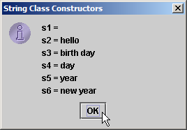
Sample code – StringConstructors.java
1 // Sample code: StringConstructors.java 2 // String class constructors. 3 import javax.swing.*; 4 5 public class StringConstructors { 6 7 public static void main( String args[] ) 8 { 9 char charArray[] = { 'b', 'i', 'r', 't', 'h', ' ', 'd', 'a', 'y' }; 10 byte byteArray[] = { ( byte ) 'n', ( byte ) 'e', 11 ( byte ) 'w', ( byte ) ' ', ( byte ) 'y', 12 ( byte ) 'e', ( byte ) 'a', ( byte ) 'r' }; 13 14 String s = new String( "hello" ); 15 16 // use String constructors 17 String s1 = new String(); 18 String s2 = new String( s ); 19 String s3 = new String( charArray ); 20 String s4 = new String( charArray, 6, 3 ); 21 String s5 = new String( byteArray, 4, 4 ); 22 String s6 = new String( byteArray ); 23 24 // append Strings to output 25 String output = "s1 = " + s1 + "\ns2 = " + s2 + "\ns3 = " + s3 + 26 "\ns4 = " + s4 + "\ns5 = " + s5 + "\ns6 = " + s6; 27 28 JOptionPane.showMessageDialog( null, output, 29 "String Class Constructors", JOptionPane.INFORMATION_MESSAGE ); 30 31 System.exit( 0 ); 32 } 33 34 } // end class StringConstructors
String default constructor instantiates empty string

Slide 10
String composing
/** * @author Patty * */ public class StringComposing1 { public static void main(String[] args) { String str1 = "Hello ", str2 = "World!"; System.out.println(str1 + str2); //System.out.println(str1 + "World!"); System.out.println(str1 + 5); | System.out.println(str1 + 17.3); System.out.println(str1 + 'D'); System.out.println(str1 + true); }//main() }/* StringComposing1 */
Output:
Hello World!
Hello 5
Hello 17.3
Hello D
Hello true

Slide 11
Sample code
/** * @author Patty * */ public class StringComposing2 { public static void main(String[] args) { String str = “ Hello "; System.out.println(1 + 2 + str); System.out.println(str + 1 + 2); System.out.println(1 + "" + 2 + str); //System.out.println(true + false + str); }//main() }/* StringComposing2 */
Output:
3 Hello
Hello 12
12 Hello
Output (no comment):
java.lang.Error: Unresolved compilation problem:
The operator + is undefined for the argument type(s) boolean, boolean

Slide 12
String Methods length, charAt and getChars
Method length
Determine String length
Like arrays, Strings always “know” their size
Unlike array, Strings do not have length instance variable
Method charAt
Get character at specific location in String
Method getChars
Get entire set of characters in String

Slide 13
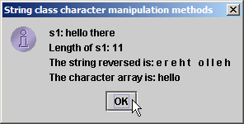
Sample code – StringMiscellaneous.java
1 // Sample code: StringMiscellaneous.java 2 // This program demonstrates the length, charAt and getChars 3 // methods of the String class. 4 import javax.swing.*; 5 6 public class StringMiscellaneous { 7 8 public static void main( String args[] ) 9 { 10 String s1 = "hello there"; 11 char charArray[] = new char[ 5 ]; 12 13 String output = "s1: " + s1; 14 15 // test length method 16 output += "\nLength of s1: " + s1.length(); 17 18 // loop through characters in s1 and display reversed 19 output += "\nThe string reversed is: "; 20 21 for ( int count = s1.length() - 1; count >= 0; count-- ) 22 output += s1.charAt( count ) + " "; 23 24 // copy characters from string into charArray 25 s1.getChars( 0, 5, charArray, 0 ); 26 output += "\nThe character array is: "; 27 28 for ( int count = 0; count < charArray.length; count++ ) 29 output += charArray[ count ]; 30 31 JOptionPane.showMessageDialog( null, output, 32 "String class character manipulation methods", 33 JOptionPane.INFORMATION_MESSAGE ); 34 35 System.exit( 0 ); 36 } 37 38 } // end class StringMiscellaneous
Determine number of characters in String s1
Append s1’s characters in reverse order to String output
Copy (some of) s1’s characters to charArray

Slide 14
Comparing Strings
Comparing String objects
Method equals
Method equalsIgnoreCase
Method compareTo
Method regionMatches

Slide 15
Sample code
/** * @author Patty * */ public class StringComparing { public static void main(String[] args) { String str1 = "Hello", str2 = "Hello"; String str3 = new String("Hello"); System.out.println(str1.equals(str2)); System.out.println(str1 == str2); System.out.println(str1.equals(str3)); | System.out.println(str1 == str3); }//main() }/* StringComparing */
Output:
true
true
true
false

Slide 16
Sample code – StringCompare.java
1 // Sample code: StringCompare.java 2 // String methods equals, equalsIgnoreCase, compareTo and regionMatches. 3 import javax.swing.JOptionPane; 4 5 public class StringCompare { 6 7 public static void main( String args[] ) 8 { 9 String s1 = new String( "hello" ); // s1 is a copy of "hello" 10 String s2 = "goodbye"; 11 String s3 = "Happy Birthday"; 12 String s4 = "happy birthday"; 13 14 String output = "s1 = " + s1 + "\ns2 = " + s2 + "\ns3 = " + s3 + 15 "\ns4 = " + s4 + "\n\n"; 16 17 // test for equality 18 if ( s1.equals( "hello" ) ) // true 19 output += "s1 equals \"hello\"\n"; 20 else 21 output += "s1 does not equal \"hello\"\n"; 22 23 // test for equality with == 24 if ( s1 == "hello" ) // false; they are not the same object 25 output += "s1 equals \"hello\"\n"; 26 else 27 output += "s1 does not equal \"hello\"\n"; 28
Method equals tests two objects for equality using lexicographical comparison
Equality operator (==) tests if both references refer to same object in memory

Slide 17
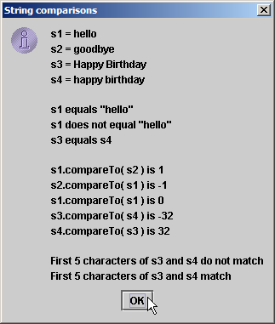
Sample code – StringCompare.java
29 // test for equality (ignore case) 30 if ( s3.equalsIgnoreCase( s4 ) ) // true 31 output += "s3 equals s4\n"; 32 else 33 output += "s3 does not equal s4\n"; 34 35 // test compareTo 36 output += "\ns1.compareTo( s2 ) is " + s1.compareTo( s2 ) + 37 "\ns2.compareTo( s1 ) is " + s2.compareTo( s1 ) + 38 "\ns1.compareTo( s1 ) is " + s1.compareTo( s1 ) + 39 "\ns3.compareTo( s4 ) is " + s3.compareTo( s4 ) + 40 "\ns4.compareTo( s3 ) is " + s4.compareTo( s3 ) + "\n\n"; 41 42 // test regionMatches (case sensitive) 43 if ( s3.regionMatches( 0, s4, 0, 5 ) ) 44 output += "First 5 characters of s3 and s4 match\n"; 45 else 46 output += "First 5 characters of s3 and s4 do not match\n"; 47 48 // test regionMatches (ignore case) 49 if ( s3.regionMatches( true, 0, s4, 0, 5 ) ) 50 output += "First 5 characters of s3 and s4 match"; 51 else 52 output += "First 5 characters of s3 and s4 do not match"; 53 54 JOptionPane.showMessageDialog( null, output, 55 "String comparisons", JOptionPane.INFORMATION_MESSAGE ); 56 57 System.exit( 0 ); 58 } 59 60 } // end class StringCompare
Test two objects for equality, but ignore case of letters in Strings
Method compareTo compares String objects
Method regionMatches compares portions of two String objects for equality

Slide 18
Sample code – StringStartEnd.java
1 // Sample code: StringStartEnd.java 2 // String methods startsWith and endsWith. 3 import javax.swing.*; 4 5 public class StringStartEnd { 6 7 public static void main( String args[] ) 8 { 9 String strings[] = { "started", "starting", "ended", "ending" }; 10 String output = ""; 11 12 // test method startsWith 13 for ( int count = 0; count < strings.length; count++ ) 14 15 if ( strings[ count ].startsWith( "st" ) ) 16 output += "\"" + strings[ count ] + "\" starts with \"st\"\n"; 17 18 output += "\n"; 19 20 // test method startsWith starting from position 21 // 2 of the string 22 for ( int count = 0; count < strings.length; count++ ) 23 24 if ( strings[ count ].startsWith( "art", 2 ) ) 25 output += "\"" + strings[ count ] + 26 "\" starts with \"art\" at position 2\n";
Method startsWith determines if String starts with specified characters

Slide 19
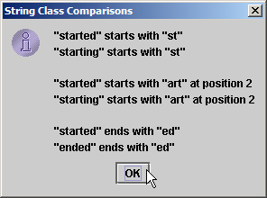
Sample code – StringStartEnd.java
27 28 output += "\n"; 29 30 // test method endsWith 31 for ( int count = 0; count < strings.length; count++ ) 32 33 if ( strings[ count ].endsWith( "ed" ) ) 34 output += "\"" + strings[ count ] + "\" ends with \"ed\"\n"; 35 36 JOptionPane.showMessageDialog( null, output, 37 "String Class Comparisons", JOptionPane.INFORMATION_MESSAGE ); 38 39 System.exit( 0 ); 40 } 41 42 } // end class StringStartEnd
Method endsWith determines if String ends with specified characters

Slide 20
Locating Characters and Substrings in Strings
Search for characters in String
Method indexOf
Returns the index within this string of the first occurrence of the specified character
Method lastIndexOf
Returns the index within this string of the last occurrence of the specified character

Slide 21
Sample code – StringIndexMethods.java
1 // Sample code: StringIndexMethods.java 2 // String searching methods indexOf and lastIndexOf. 3 import javax.swing.*; 4 5 public class StringIndexMethods { 6 7 public static void main( String args[] ) 8 { 9 String letters = "abcdefghijklmabcdefghijklm"; 10 11 // test indexOf to locate a character in a string 12 String output = "'c' is located at index " + letters.indexOf( 'c' ); 13 14 output += "\n'a' is located at index " + letters.indexOf( 'a', 1 ); 15 16 output += "\n'$' is located at index " + letters.indexOf( '$' ); 17 18 // test lastIndexOf to find a character in a string 19 output += "\n\nLast 'c' is located at index " + 20 letters.lastIndexOf( 'c' ); 21 22 output += "\nLast 'a' is located at index " + 23 letters.lastIndexOf( 'a', 25 ); 24 25 output += "\nLast '$' is located at index " + 26 letters.lastIndexOf( '$' ); 27
Method indexOf finds first occurrence of character in String
Method lastIndexOf finds last occurrence of character in String

Slide 22
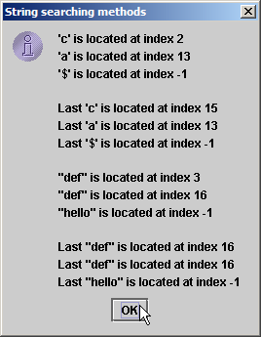
Sample code – StringIndexMethods.java
28 // test indexOf to locate a substring in a string 29 output += "\n\n\"def\" is located at index " + 30 letters.indexOf( "def" ); 31 32 output += "\n\"def\" is located at index " + 33 letters.indexOf( "def", 7 ); 34 35 output += "\n\"hello\" is located at index " + 36 letters.indexOf( "hello" ); 37 38 // test lastIndexOf to find a substring in a string 39 output += "\n\nLast \"def\" is located at index " + 40 letters.lastIndexOf( "def" ); 41 42 output += "\nLast \"def\" is located at index " + 43 letters.lastIndexOf( "def", 25 ); 44 45 output += "\nLast \"hello\" is located at index " + 46 letters.lastIndexOf( "hello" ); 47 48 JOptionPane.showMessageDialog( null, output, 49 "String searching methods", JOptionPane.INFORMATION_MESSAGE ); 50 51 System.exit( 0 ); 52 } 53 54 } // end class StringIndexMethods
Methods indexOf and lastIndexOf can also find occurrences of substrings

Slide 23
Extracting Substrings from Strings
Create Strings from other Strings
Method substring
Returns a new string that is a substring of this string

Slide 24
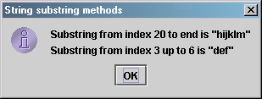
Sample code – SubString.java
1 // Sample code: SubString.java 2 // String class substring methods. 3 import javax.swing.*; 4 5 public class SubString { 6 7 public static void main( String args[] ) 8 { 9 String letters = "abcdefghijklmabcdefghijklm"; 10 11 // test substring methods 12 String output = "Substring from index 20 to end is " + 13 "\"" + letters.substring( 20 ) + "\"\n"; 14 15 output += "Substring from index 3 up to 6 is " + 16 "\"" + letters.substring( 3, 6 ) + "\""; 17 18 JOptionPane.showMessageDialog( null, output, 19 "String substring methods", JOptionPane.INFORMATION_MESSAGE ); 20 21 System.exit( 0 ); 22 } 23 24 } // end class SubString
Beginning at index 20, extract characters from String letters
Extract characters from index 3 to 6 from String letters

Slide 25
Concatenating Strings
Method concat
Concatenate two String objects
Concatenates the specified string to the end of this string

Slide 26
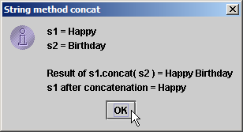
Sample code – StringConcatenation.java
1 // Sample code: StringConcatenation.java 2 // String concat method. 3 import javax.swing.*; 4 5 public class StringConcatenation { 6 7 public static void main( String args[] ) 8 { 9 String s1 = new String( "Happy " ); 10 String s2 = new String( "Birthday" ); 11 12 String output = "s1 = " + s1 + "\ns2 = " + s2; 13 14 output += "\n\nResult of s1.concat( s2 ) = " + s1.concat( s2 ); 15 output += "\ns1 after concatenation = " + s1; 16 17 JOptionPane.showMessageDialog( null, output, 18 "String method concat", JOptionPane.INFORMATION_MESSAGE ); 19 20 System.exit( 0 ); 21 } 22 23 } // end class StringConcatenation
Concatenate String s2 to String s1
However, String s1 is not modified by method concat

Slide 27
Miscellaneous String Methods
Miscellaneous String methods
Return modified copies of String
Return character array

Slide 28
Sample code – StringMiscellaneous2.java
1 // Sample code: StringMiscellaneous2.java 2 // String methods replace, toLowerCase, toUpperCase, trim and toCharArray. 3 import javax.swing.*; 4 5 public class StringMiscellaneous2 { 6 7 public static void main( String args[] ) 8 { 9 String s1 = new String( "hello" ); 10 String s2 = new String( "GOODBYE" ); 11 String s3 = new String( " spaces " ); 12 13 String output = "s1 = " + s1 + "\ns2 = " + s2 + "\ns3 = " + s3; 14 15 // test method replace 16 output += "\n\nReplace 'l' with 'L' in s1: " + 17 s1.replace( 'l', 'L' ); 18 19 // test toLowerCase and toUpperCase 20 output += "\n\ns1.toUpperCase() = " + s1.toUpperCase() + 21 "\ns2.toLowerCase() = " + s2.toLowerCase(); 22 23 // test trim method 24 output += "\n\ns3 after trim = \"" + s3.trim() + "\""; 25
Use method replace to return s1 copy in which every occurrence of ‘l’ is replaced with ‘L’
Use method toUpperCase to return s1 copy in which every character is uppercase
Use method toLowerCase to return s2 copy in which every character is uppercase
Use method trim to return s3 copy in which whitespace is eliminated

Slide 29
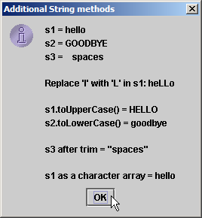
Sample code – StringMiscellaneous2.java
26 // test toCharArray method 27 char charArray[] = s1.toCharArray(); 28 output += "\n\ns1 as a character array = "; 29 30 for ( int count = 0; count < charArray.length; ++count ) 31 output += charArray[ count ]; 32 33 JOptionPane.showMessageDialog( null, output, 34 "Additional String methods", JOptionPane.INFORMATION_MESSAGE ); 35 36 System.exit( 0 ); 37 } 38 39 } // end class StringMiscellaneous2
Use method toCharArray to return character array of s1

Slide 30
String Method valueOf
String provides static class methods
Method valueOf
Return the String representation of the specified type value
Returns String representation of object, data, etc.

Slide 31
Sample code
/** * @author Patty * */ public class StringMethods { public static void main(String[] args) { String str = "Hello World!"; System.out.println(str.length()); for(int i = 0; i < str.length(); i++) System.out.print(str.charAt(i)); | String strN = String.valueOf(129); System.out.println('\n' + strN); }//main() }/* StringMethods */
Output:
12
Hello World!
129

Slide 32
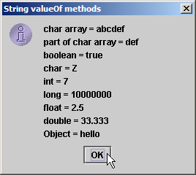
Sample code – StringValueOf.java
1 // Sample code: StringValueOf.java 2 // String valueOf methods. 3 import javax.swing.*; 4 5 public class StringValueOf { 6 7 public static void main( String args[] ) 8 { 9 char charArray[] = { 'a', 'b', 'c', 'd', 'e', 'f' }; 10 boolean booleanValue = true; 11 char characterValue = 'Z'; 12 int integerValue = 7; 13 long longValue = 10000000L; 14 float floatValue = 2.5f; // f suffix indicates that 2.5 is a float 15 double doubleValue = 33.333; 16 Object objectRef = "hello"; // assign string to an Object reference 17 18 String output = "char array = " + String.valueOf( charArray ) + 19 "\npart of char array = " + String.valueOf( charArray, 3, 3 ) + 20 "\nboolean = " + String.valueOf( booleanValue ) + 21 "\nchar = " + String.valueOf( characterValue ) + 22 "\nint = " + String.valueOf( integerValue ) + 23 "\nlong = " + String.valueOf( longValue ) + 24 "\nfloat = " + String.valueOf( floatValue ) + 25 "\ndouble = " + String.valueOf( doubleValue ) + 26 "\nObject = " + String.valueOf( objectRef ); 27 28 JOptionPane.showMessageDialog( null, output, 29 "String valueOf methods", JOptionPane.INFORMATION_MESSAGE ); 30 31 System.exit( 0 ); 32 } 33 34 } // end class StringValueOf
static method valueOf of class String returns String representation of various types

Slide 33
StringBuffer

Slide 34
Class StringBuffer
Class StringBuffer
When String object is created, its contents cannot change
Used for creating and manipulating dynamic string data
i.e., modifiable Strings
Can store characters based on capacity
Capacity expands dynamically to handle additional characters
Uses operators + and += for String concatenation

Slide 35
StringBuffer Constructors
Three StringBuffer constructors
Default creates StringBuffer with no characters
Capacity of 16 characters

Slide 36
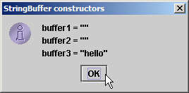
Sample code – StringBufferConstructors.java
1 // Sample code: StringBufferConstructors.java 2 // StringBuffer constructors. 3 import javax.swing.*; 4 5 public class StringBufferConstructors { 6 7 public static void main( String args[] ) 8 { 9 StringBuffer buffer1 = new StringBuffer(); 10 StringBuffer buffer2 = new StringBuffer( 10 ); 11 StringBuffer buffer3 = new StringBuffer( "hello" ); 12 13 String output = "buffer1 = \"" + buffer1.toString() + "\"" + 14 "\nbuffer2 = \"" + buffer2.toString() + "\"" + 15 "\nbuffer3 = \"" + buffer3.toString() + "\""; 16 17 JOptionPane.showMessageDialog( null, output, 18 "StringBuffer constructors", JOptionPane.INFORMATION_MESSAGE ); 19 20 System.exit( 0 ); 21 } 22 23 } // end class StringBufferConstructors
Default constructor creates empty StringBuffer with capacity of 16 characters
Second constructor creates empty StringBuffer with capacity of specified (10) characters
Third constructor creates StringBuffer with String “hello” and capacity of 16 characters
Method toString returns String representation of StringBuffer

Slide 37
StringBuffer Methods length, capacity, setLength and ensureCapacity
Method length
Return StringBuffer length
Method capacity
Return StringBuffer capacity
Method setLength
Increase or decrease StringBuffer length
Method ensureCapacity
Set StringBuffer capacity
Guarantee that StringBuffer has minimum capacity

Slide 38
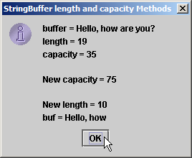
Sample code – StringBufferCapLen.java
1 // Sample code: StringBufferCapLen.java 2 // StringBuffer length, setLength, capacity and ensureCapacity methods. 3 import javax.swing.*; 4 5 public class StringBufferCapLen { 6 7 public static void main( String args[] ) 8 { 9 StringBuffer buffer = new StringBuffer( "Hello, how are you?" ); 10 11 String output = "buffer = " + buffer.toString() + "\nlength = " + 12 buffer.length() + "\ncapacity = " + buffer.capacity(); 13 14 buffer.ensureCapacity( 75 ); 15 output += "\n\nNew capacity = " + buffer.capacity(); 16 17 buffer.setLength( 10 ); 18 output += "\n\nNew length = " + buffer.length() + 19 "\nbuf = " + buffer.toString(); 20 21 JOptionPane.showMessageDialog( null, output, 22 "StringBuffer length and capacity Methods", 23 JOptionPane.INFORMATION_MESSAGE ); 24 25 System.exit( 0 ); 26 } 27 28 } // end class StringBufferCapLen
Method capacity returns StringBuffer capacity
Use method ensureCapacity to set capacity to 75
Use method setLength to set length to 10

Slide 39
StringBuffer Methods
Manipulating StringBuffer characters
Method charAt
Return StringBuffer character at specified index
Method setCharAt
Set StringBuffer character at specified index
Method getChars
Return character array from StringBuffer
Method reverse
Reverse StringBuffer contents

Slide 40
Sample code – StringBufferChars.java
1 // Sample code: StringBufferChars.java 2 // StringBuffer methods charAt, setCharAt, getChars and reverse. 3 import javax.swing.*; 4 5 public class StringBufferChars { 6 7 public static void main( String args[] ) 8 { 9 StringBuffer buffer = new StringBuffer( "hello there" ); 10 11 String output = "buffer = " + buffer.toString() + 12 "\nCharacter at 0: " + buffer.charAt( 0 ) + 13 "\nCharacter at 4: " + buffer.charAt( 4 ); 14 15 char charArray[] = new char[ buffer.length() ]; 16 buffer.getChars( 0, buffer.length(), charArray, 0 ); 17 output += "\n\nThe characters are: "; 18 19 for ( int count = 0; count < charArray.length; ++count ) 20 output += charArray[ count ]; 21 22 buffer.setCharAt( 0, 'H' ); 23 buffer.setCharAt( 6, 'T' ); 24 output += "\n\nbuf = " + buffer.toString(); 25
Return StringBuffer characters at indices 0 and 4, respectively
Return character array from StringBuffer
Replace characters at indices 0 and 6 with ‘H’ and ‘T,’ respectively

Slide 41
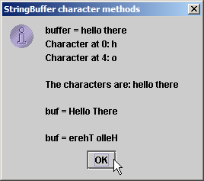
Sample code – StringBufferChars.java
26 buffer.reverse(); 27 output += "\n\nbuf = " + buffer.toString(); 28 29 JOptionPane.showMessageDialog( null, output, 30 "StringBuffer character methods", 31 JOptionPane.INFORMATION_MESSAGE ); 32 33 System.exit( 0 ); 34 } 35 36 } // end class StringBufferChars
Reverse characters in StringBuffer

Slide 42
StringBuffer append Methods
Method append
Allow data values to be added to StringBuffer

Slide 43
Sample code – StringBufferAppend.java
1 // Sample code : StringBufferAppend.java 2 // StringBuffer append methods. 3 import javax.swing.*; 4 5 public class StringBufferAppend { 6 7 public static void main( String args[] ) 8 { 9 Object objectRef = "hello"; 10 String string = "goodbye"; 11 char charArray[] = { 'a', 'b', 'c', 'd', 'e', 'f' }; 12 boolean booleanValue = true; 13 char characterValue = 'Z'; 14 int integerValue = 7; 15 long longValue = 10000000; 16 float floatValue = 2.5f; // f suffix indicates 2.5 is a float 17 double doubleValue = 33.333; 18 StringBuffer lastBuffer = new StringBuffer( "last StringBuffer" ); 19 StringBuffer buffer = new StringBuffer(); 20 21 buffer.append( objectRef ); 22 buffer.append( " " ); // each of these contains two spaces 23 buffer.append( string ); 24 buffer.append( " " ); 25 buffer.append( charArray ); 26 buffer.append( " " ); 27 buffer.append( charArray, 0, 3 );
Append String “hello” to StringBuffer
Append String “goodbye”
Append “a b c d e f”
Append “a b c”

Slide 44
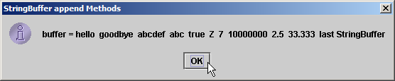
Sample code – StringBufferAppend.java
28 buffer.append( " " ); 29 buffer.append( booleanValue ); 30 buffer.append( " " ); 31 buffer.append( characterValue ); 32 buffer.append( " " ); 33 buffer.append( integerValue ); 34 buffer.append( " " ); 35 buffer.append( longValue ); 36 buffer.append( " " ); 37 buffer.append( floatValue ); 38 buffer.append( " " ); 39 buffer.append( doubleValue ); 40 buffer.append( " " ); 41 buffer.append( lastBuffer ); 42 43 JOptionPane.showMessageDialog( null, 44 "buffer = " + buffer.toString(), "StringBuffer append Methods", 45 JOptionPane.INFORMATION_MESSAGE ); 46 47 System.exit( 0 ); 48 } 49 50 } // end StringBufferAppend
Append boolean, char, int, long, float and double

Slide 45
StringBuffer Insertion and Deletion Methods
Method insert
Allow data-type values to be inserted into StringBuffer
Methods delete and deleteCharAt
Allow characters to be removed from StringBuffer

Slide 46
Sample code – StringBufferInsert.java
1 // Sample code : StringBufferInsert.java 2 // StringBuffer methods insert and delete. 3 import javax.swing.*; 4 5 public class StringBufferInsert { 6 7 public static void main( String args[] ) 8 { 9 Object objectRef = "hello"; 10 String string = "goodbye"; 11 char charArray[] = { 'a', 'b', 'c', 'd', 'e', 'f' }; 12 boolean booleanValue = true; 13 char characterValue = 'K'; 14 int integerValue = 7; 15 long longValue = 10000000; 16 float floatValue = 2.5f; // f suffix indicates that 2.5 is a float 17 double doubleValue = 33.333; 18 StringBuffer buffer = new StringBuffer(); 19 20 buffer.insert( 0, objectRef ); 21 buffer.insert( 0, " " ); // each of these contains two spaces 22 buffer.insert( 0, string ); 23 buffer.insert( 0, " " ); 24 buffer.insert( 0, charArray ); 25 buffer.insert( 0, " " ); 26 buffer.insert( 0, charArray, 3, 3 );
Use method insert to insert data in beginning of StringBuffer

Slide 47
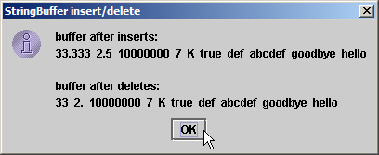
Sample code – StringBufferInsert.java
27 buffer.insert( 0, " " ); 28 buffer.insert( 0, booleanValue ); 29 buffer.insert( 0, " " ); 30 buffer.insert( 0, characterValue ); 31 buffer.insert( 0, " " ); 32 buffer.insert( 0, integerValue ); 33 buffer.insert( 0, " " ); 34 buffer.insert( 0, longValue ); 35 buffer.insert( 0, " " ); 36 buffer.insert( 0, floatValue ); 37 buffer.insert( 0, " " ); 38 buffer.insert( 0, doubleValue ); 39 40 String output = "buffer after inserts:\n" + buffer.toString(); 41 42 buffer.deleteCharAt( 10 ); // delete 5 in 2.5 43 buffer.delete( 2, 6 ); // delete .333 in 33.333 44 45 output += "\n\nbuffer after deletes:\n" + buffer.toString(); 46 47 JOptionPane.showMessageDialog( null, output, 48 "StringBuffer insert/delete", JOptionPane.INFORMATION_MESSAGE ); 49 50 System.exit( 0 ); 51 } 52 53 } // end class StringBufferInsert
Use method insert to insert data in beginning of StringBuffer
Use method deleteCharAt to remove character from index 10 in StringBuffer
Remove characters from indices 2 through 5 (inclusive)

Slide 48
Class Character
Treat primitive variables as objects
Type wrapper classes
Boolean
Character
Double
Float
Byte
Short
Integer
Long
We examine class Character

Slide 49
Sample code – StaticCharMethods.java
1 // Sample code: StaticCharMethods.java 2 // Static Character testing methods and case conversion methods. 3 import java.awt.*; 4 import java.awt.event.*; 5 import javax.swing.*; 6 7 public class StaticCharMethods extends JFrame { 8 private char c; 9 private JLabel promptLabel; 10 private JTextField inputField; 11 private JTextArea outputArea; 12 13 // constructor builds GUI 14 public StaticCharMethods() 15 { 16 super( "Static Character Methods" ); 17 18 Container container = getContentPane(); 19 container.setLayout( new FlowLayout() ); 20 21 promptLabel = new JLabel( "Enter a character and press Enter" ); 22 container.add( promptLabel ); 23 inputField = new JTextField( 5 ); 24

Slide 50
Sample code – StaticCharMethods.java
25 inputField.addActionListener( 26 27 new ActionListener() { // anonymous inner class 28 29 // handle textfield event 30 public void actionPerformed( ActionEvent event ) 31 { 32 String s = event.getActionCommand(); 33 c = s.charAt( 0 ); 34 buildOutput(); 35 } 36 37 } // end anonymous inner class 38 39 ); // end call to addActionListener 40 41 container.add( inputField ); 42 outputArea = new JTextArea( 10, 20 ); 43 container.add( outputArea ); 44 45 setSize( 300, 220 ); // set the window size 46 setVisible( true ); // show the window 47 48 } // end constructor 49

Slide 51
Sample code – StaticCharMethods.java
50 // display character info in outputArea 51 private void buildOutput() 52 { 53 outputArea.setText( "is defined: " + Character.isDefined( c ) + 54 "\nis digit: " + Character.isDigit( c ) + 55 "\nis first character in a Java identifier: " + 56 Character.isJavaIdentifierStart( c ) + 57 "\nis part of a Java identifier: " + 58 Character.isJavaIdentifierPart( c ) + 59 "\nis letter: " + Character.isLetter( c ) + 60 "\nis letter or digit: " + Character.isLetterOrDigit( c ) + 61 "\nis lower case: " + Character.isLowerCase( c ) + 62 "\nis upper case: " + Character.isUpperCase( c ) + 63 "\nto upper case: " + Character.toUpperCase( c ) + 64 "\nto lower case: " + Character.toLowerCase( c ) ); 65 } 66 67 // create StaticCharMethods object to begin execution 68 public static void main( String args[] ) 69 { 70 StaticCharMethods application = new StaticCharMethods(); 71 application.setDefaultCloseOperation( JFrame.EXIT_ON_CLOSE ); 72 } 73 74 } // end class StaticCharMethods
Determine whether c is defined Unicode digit
Determine whether c can be used as first character in identifier
Determine whether c is letter or digit
Determine whether c is a letter
Determine whether c is uppercase or lowercase
Determine whether c can be used as identifier character

Slide 52
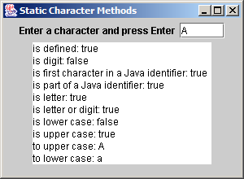
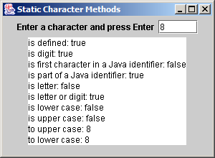
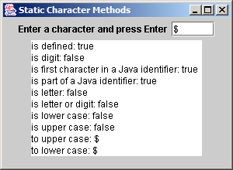
Sample code – StaticCharMethods.java

Slide 53
Sample code – StaticCharMethods2.java
1 // Sample code: StaticCharMethods2.java 2 // Static Character conversion methods. 3 import java.awt.*; 4 import java.awt.event.*; 5 import javax.swing.*; 6 7 public class StaticCharMethods2 extends JFrame { 8 private char c; 9 private int digit, radix; 10 private JLabel prompt1, prompt2; 11 private JTextField input, radixField; 12 private JButton toChar, toInt; 13 14 // constructor builds GUI 15 public StaticCharMethods2() 16 { 17 super( "Character Conversion Methods" ); 18 19 Container container = getContentPane(); 20 container.setLayout( new FlowLayout() ); 21 22 prompt1 = new JLabel( "Enter a digit or character " ); 23 input = new JTextField( 5 ); 24 container.add( prompt1 ); 25 container.add( input );

Slide 54
Sample code – StaticCharMethods2.java
27 prompt2 = new JLabel( "Enter a radix " ); 28 radixField = new JTextField( 5 ); 29 container.add( prompt2 ); 30 container.add( radixField ); 31 32 toChar = new JButton( "Convert digit to character" ); 33 toChar.addActionListener( 34 35 new ActionListener() { // anonymous inner class 36 37 // handle toChar JButton event 38 public void actionPerformed( ActionEvent actionEvent ) 39 { 40 digit = Integer.parseInt( input.getText() ); 41 radix = Integer.parseInt( radixField.getText() ); 42 JOptionPane.showMessageDialog( null, 43 "Convert digit to character: " + 44 Character.forDigit( digit, radix ) ); 45 } 46 47 } // end anonymous inner class 48 49 ); // end call to addActionListener 50

Slide 55
Sample code – StaticCharMethods2.java
51 toInt = new JButton( "Convert character to digit" ); 52 toInt.addActionListener( 53 54 new ActionListener() { // anonymous inner class 55 56 // handle toInt JButton event 57 public void actionPerformed( ActionEvent actionEvent ) 58 { 59 String s = input.getText(); 60 c = s.charAt( 0 ); 61 radix = Integer.parseInt( radixField.getText() ); 62 JOptionPane.showMessageDialog( null, 63 "Convert character to digit: " + 64 Character.digit( c, radix ) ); 65 } 66 67 } // end anonymous inner class 68 69 ); // end call to addActionListener 70 71 container.add( toChar ); 72 container.add( toInt ); 73 setSize( 275, 150 ); // set the window size 74 setVisible( true ); // show the window 75 } 77 // create StaticCharMethods2 object execute application 78 public static void main( String args[] ) 79 { 80 StaticCharMethods2 application = new StaticCharMethods2(); 81 application.setDefaultCloseOperation( JFrame.EXIT_ON_CLOSE ); 82 } 83 84 } // end class StaticCharMethods2
Use method digit to convert char c to number-system integer specified by int radix

Slide 56
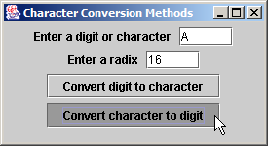
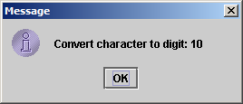
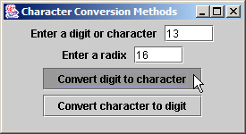
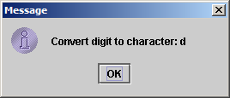
Sample code – StaticCharMethods2.java

Slide 57
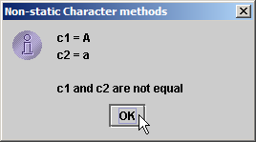
Sample code – OtherCharMethods.java
1 // Sample code: OtherCharMethods.java 2 // Non-static Character methods. 3 import javax.swing.*; 4 5 public class OtherCharMethods { 6 7 public static void main( String args[] ) 8 { 9 Character c1 = new Character( 'A' ); 10 Character c2 = new Character( 'a' ); 11 12 String output = "c1 = " + c1.charValue() + 13 "\nc2 = " + c2.toString(); 14 15 if ( c1.equals( c2 ) ) 16 output += "\n\nc1 and c2 are equal"; 17 else 18 output += "\n\nc1 and c2 are not equal"; 19 20 JOptionPane.showMessageDialog( null, output, 21 "Non-static Character methods", 22 JOptionPane.INFORMATION_MESSAGE ); 23 24 System.exit( 0 ); 25 } 26 27 } // end class OtherCharMethods
Characters non-static methods charValue, toString and equals

Slide 58
Class StringTokenizer
Tokenizer
Partition String into individual substrings
Use delimiter
Java offers java.util.StringTokenizer

Slide 59
Sample code – TokenTest.java
1 // Sample code: TokenTest.java 2 // StringTokenizer class. 3 import java.util.*; 4 import java.awt.*; 5 import java.awt.event.*; 6 import javax.swing.*; 7 8 public class TokenTest extends JFrame { 9 private JLabel promptLabel; 10 private JTextField inputField; 11 private JTextArea outputArea; 12 13 // set up GUI and event handling 14 public TokenTest() 15 { 16 super( "Testing Class StringTokenizer" ); 17 18 Container container = getContentPane(); 19 container.setLayout( new FlowLayout() ); 20 21 promptLabel = new JLabel( "Enter a sentence and press Enter" ); 22 container.add( promptLabel ); 23 24 inputField = new JTextField( 20 );
inputField contains String to be parsed by StringTokenizer

Slide 60
Sample code – TokenTest.java
25 inputField.addActionListener( 26 27 new ActionListener() { // anonymous inner class 28 29 // handle text field event 30 public void actionPerformed( ActionEvent event ) 31 { 32 StringTokenizer tokens = 33 new StringTokenizer( event.getActionCommand() ); 34 35 outputArea.setText( "Number of elements: " + 36 tokens.countTokens() + "\nThe tokens are:\n" ); 37 38 while ( tokens.hasMoreTokens() ) 39 outputArea.append( tokens.nextToken() + "\n" ); 40 } 41 42 } // end anonymous inner class 43 44 ); // end call to addActionListener 45 46 container.add( inputField ); 47 48 outputArea = new JTextArea( 10, 20 ); 49 outputArea.setEditable( false ); 50 container.add( new JScrollPane( outputArea ) ); 51 setSize( 275, 240 ); // set the window size 52 setVisible( true ); // show the window 53 }
Use StringTokenizer to parse String using default delimiter “ \n\t\r”
Count number of tokens
Append next token to outputArea, as long as tokens exist

Slide 61
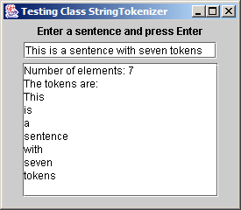
Sample code – TokenTest.java
54 55 // execute application 56 public static void main( String args[] ) 57 { 58 TokenTest application = new TokenTest(); 59 application.setDefaultCloseOperation( JFrame.EXIT_ON_CLOSE ); 60 } 61 62 } // end class TokenTest

Slide 62
Card Shuffling and Dealing Simulation
Develop DeckOfCards application
Create deck of 52 playing cards using Card objects
User deals card by clicking “Deal card” button
User shuffles deck by clicking “Shuffle cards” button
Use random-number generation

Slide 63
Sample code – DeckOfCards.java
1 // Sample code : DeckOfCards.java 2 // Card shuffling and dealing program. 3 import java.awt.*; 4 import java.awt.event.*; 5 import javax.swing.*; 6 7 public class DeckOfCards extends JFrame { 8 private Card deck[]; 9 private int currentCard; 10 private JButton dealButton, shuffleButton; 11 private JTextField displayField; 12 private JLabel statusLabel; 13 14 // set up deck of cards and GUI 15 public DeckOfCards() 16 { 17 super( "Card Dealing Program" ); 18 19 String faces[] = { "Ace", "Deuce", "Three", "Four", "Five", "Six", 20 "Seven", "Eight", "Nine", "Ten", "Jack", "Queen", "King" }; 21 String suits[] = { "Hearts", "Diamonds", "Clubs", "Spades" }; 22 23 deck = new Card[ 52 ]; 24 currentCard = -1; 25
Deck of 52 Cards
Most recently dealt Cards in deck array (-1 if no Cards have been dealt)

Slide 64
Sample code – DeckOfCards.java
26 // populate deck with Card objects 27 for ( int count = 0; count < deck.length; count++ ) 28 deck[ count ] = new Card( faces[ count % 13 ], 29 suits[ count / 13 ] ); 30 31 // set up GUI and event handling 32 Container container = getContentPane(); 33 container.setLayout( new FlowLayout() ); 34 35 dealButton = new JButton( "Deal card" ); 36 dealButton.addActionListener( 37 38 new ActionListener() { // anonymous inner class 39 40 // deal one card 41 public void actionPerformed( ActionEvent actionEvent ) 42 { 43 Card dealt = dealCard(); 44 45 if ( dealt != null ) { 46 displayField.setText( dealt.toString() ); 47 statusLabel.setText( "Card #: " + currentCard ); 48 } 49 else { 50 displayField.setText( "NO MORE CARDS TO DEAL" ); 51 statusLabel.setText( "Shuffle cards to continue" ); 52 } 53
Fill deck array with Cards
When user presses Deal Card button, method dealCard gets next card in deck array
Display Card in JTextField

Slide 65
Sample code – DeckOfCards.java
54 55 } // end anonymous inner class 56 57 ); // end call to addActionListener 58 59 container.add( dealButton ); 60 61 shuffleButton = new JButton( "Shuffle cards" ); 62 shuffleButton.addActionListener( 63 64 new ActionListener() { // anonymous inner class 65 66 // shuffle deck 67 public void actionPerformed( ActionEvent actionEvent ) 68 { 69 displayField.setText( "SHUFFLING ..." ); 70 shuffle(); 71 displayField.setText( "DECK IS SHUFFLED" ); 72 } 73 74 } // end anonymous inner class 75 76 ); // end call to addActionListener 77 78 container.add( shuffleButton );
When user presses Shuffle Cards button, method shuffle shuffles cards

Slide 66
Sample code – DeckOfCards.java
80 displayField = new JTextField( 20 ); 81 displayField.setEditable( false ); 82 container.add( displayField ); 83 84 statusLabel = new JLabel(); 85 container.add( statusLabel ); 86 87 setSize( 275, 120 ); // set window size 88 setVisible( true ); // show window 89 } 90 91 // shuffle deck of cards with one-pass algorithm 92 private void shuffle() 93 { 94 currentCard = -1; 95 96 // for each card, pick another random card and swap them 97 for ( int first = 0; first < deck.length; first++ ) { 98 int second = ( int ) ( Math.random() * 52 ); 99 Card temp = deck[ first ]; 100 deck[ first ] = deck[ second ]; 101 deck[ second ] = temp; 102 } 103
Shuffle cards by swapping each Card with randomly selected Card

Slide 67
Sample code – DeckOfCards.java
104 dealButton.setEnabled( true ); 105 } 106 107 // deal one card 108 private Card dealCard() 109 { 110 if ( ++currentCard < deck.length ) 111 return deck[ currentCard ]; 112 else { 113 dealButton.setEnabled( false ); 114 return null; 115 } 116 } 117 118 // execute application 119 public static void main( String args[] ) 120 { 121 DeckOfCards application = new DeckOfCards(); 122 123 application.setDefaultCloseOperation( JFrame.EXIT_ON_CLOSE ); 124 } 125 126 } // end class DeckOfCards 127
If deck is not empty, a Card object reference is returned; otherwise, null is returned
Method setEnabled enables and disables JButton

Slide 68
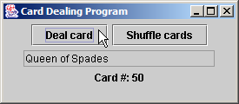
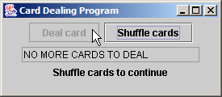
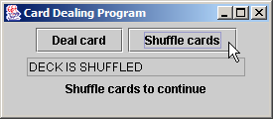
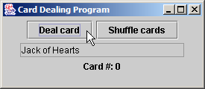
Sample code – DeckOfCards.java
128 // class to represent a card 129 class Card { 130 private String face; 131 private String suit; 132 133 // constructor to initialize a card 134 public Card( String cardFace, String cardSuit ) 135 { 136 face = cardFace; 137 suit = cardSuit; 138 } 139 140 // return String represenation of Card 141 public String toString() 142 { 143 return face + " of " + suit; 144 } 145 146 } // end class Card
Store face name and suit for specific Card, respectively

Slide 69
Regular Expressions, Class Pattern and Class Matcher
Regular expression
Sequence of characters and symbols
Define set of strings
Class Pattern
An immutable regular expression
Class Match
A regular expression matching operation

Slide 70
Regular Expressions, Class Pattern and Class Matcher
Character | Matches | Character | Matchers
\d | Any digit | \D | Any non-digit
\w | Any word character | \W | Any non-word character
\s | Any whitespace | \S | Any non-whitespace

Slide 71
Regular Expressions, Class Pattern and Class Matcher
Quantifier | Matches
* | Matches zero or more occurrences of the pattern.
+ | Matches one or more occurrences of the pattern.
? | Matches zero or one occurrences of the pattern.
{n} | Matches exactly n occurrences.
{n, } | Matches at least n occurrences.
{n, m} | Matches between n and m (inclusive) occurrences.

Slide 72
Sample code – ValidateFrame.java
1 // Sample code: ValidateFrame.java 2 // Validate user information using regular expressions. 3 import java.awt.*; 4 import java.awt.event.*; 5 import javax.swing.*; 6 7 public class ValidateFrame extends JFrame { 8 private JTextField phoneTextField, zipTextField, stateTextField, 9 cityTextField, addressTextField, firstTextField, lastTextField; 10 11 public ValidateFrame() 12 { 13 super( "Validate" ); 14 15 // create the GUI components 16 JLabel phoneLabel = new JLabel( "Phone" ); 17 JLabel zipLabel = new JLabel( "Zip" ); 18 JLabel stateLabel = new JLabel( "State" ); 19 JLabel cityLabel = new JLabel( "City" ); 20 JLabel addressLabel = new JLabel( "Address" ); 21 JLabel firstLabel = new JLabel( "First Name" ); 22 JLabel lastLabel = new JLabel( "Last Name" ); 23 24 JButton okButton = new JButton( "OK" );

Slide 73
Sample code – ValidateFrame.java
25 okButton.addActionListener( 26 27 new ActionListener() { // inner class 28 29 public void actionPerformed( ActionEvent event ) { 30 validateDate(); 31 } 32 33 } // end inner class 34 35 ); // end call to addActionListener 36 37 phoneTextField = new JTextField( 15 ); 38 zipTextField = new JTextField( 5 ); 39 stateTextField = new JTextField( 2 ); 40 cityTextField = new JTextField( 12 ); 41 addressTextField = new JTextField( 20 ); 42 firstTextField = new JTextField( 20 ); 43 lastTextField = new JTextField( 20 ); 44 45 JPanel firstName = new JPanel(); 46 firstName.add( firstLabel ); 47 firstName.add( firstTextField ); 48 49 JPanel lastName = new JPanel(); 50 lastName.add( lastLabel ); 51 lastName.add( lastTextField );

Slide 74
Sample code – ValidateFrame.java
52 53 JPanel address1 = new JPanel(); 54 address1.add( addressLabel ); 55 address1.add( addressTextField ); 56 57 JPanel address2 = new JPanel(); 58 address2.add( cityLabel ); 59 address2.add( cityTextField ); 60 address2.add( stateLabel ); 61 address2.add( stateTextField ); 62 address2.add( zipLabel ); 63 address2.add( zipTextField ); 64 65 JPanel phone = new JPanel(); 66 phone.add( phoneLabel ); 67 phone.add( phoneTextField ); 68 69 JPanel ok = new JPanel(); 70 ok.add( okButton ); 71 72 // add the components to the application 73 Container container = getContentPane(); 74 container.setLayout( new GridLayout( 6, 1 ) ); 75

Slide 75
Sample code – ValidateFrame.java
76 container.add( firstName ); 77 container.add( lastName ); 78 container.add( address1 ); 79 container.add( address2 ); 80 container.add( phone ); 81 container.add( ok ); 82 83 setSize( 325, 225 ); 84 setVisible( true ); 85 86 } // end ValidateFrame constructor 87 88 public static void main( String args[] ) 89 { 90 ValidateFrame application = new ValidateFrame(); 91 application.setDefaultCloseOperation( JFrame.EXIT_ON_CLOSE ); 92 } 93 94 // handles okButton action event

Slide 76
Sample code – ValidateFrame.java
95 private void validateDate() 96 { 97 // ensure that no textboxes are empty 98 if ( lastTextField.getText().equals( "" ) || 99 firstTextField.getText().equals( "" ) || 100 addressTextField.getText().equals( "" ) || 101 cityTextField.getText().equals( "" ) || 102 stateTextField.getText().equals( "" ) || 103 zipTextField.getText().equals( "" ) || 104 phoneTextField.getText().equals( "" ) ) // end condition 105 106 JOptionPane.showMessageDialog( this, "Please fill all fields" ); 107 108 // if first name format invalid show message 109 else if ( !firstTextField.getText().matches( "[A-Z][a-zA-Z]*" ) ) 110 JOptionPane.showMessageDialog( this, "Invalid first name" ); 111 112 // if last name format invalid show message 113 else if ( !lastTextField.getText().matches( "[A-Z][a-zA-Z]*" ) ) 114 JOptionPane.showMessageDialog( this, "Invalid last name" ); 115 116 // if address format invalid show message 117 else if ( !addressTextField.getText().matches( 118 "\\d+\\s+([a-zA-Z]+|[a-zA-Z]+\\s[a-zA-Z]+)" ) ) 119 JOptionPane.showMessageDialog( this, "Invalid address" ); 120
Matches returns true if the String matches the regular expression

Slide 77
Sample code – ValidateFrame.java
121 // if city format invalid show message 122 else if ( !cityTextField.getText().matches( 123 "([a-zA-Z]+|[a-zA-Z]+\\s[a-zA-Z]+)" ) ) 124 JOptionPane.showMessageDialog( this, "Invalid city" ); 125 126 // if state format invalid show message 127 else if ( !stateTextField.getText().matches( 128 "([a-zA-Z]+|[a-zA-Z]+\\s[a-zA-Z]+)" ) ) 129 JOptionPane.showMessageDialog( this, "Invalid state" ); 130 131 // if zip code format invalid show message 132 else if ( !zipTextField.getText().matches( "\\d{5}" ) ) 133 JOptionPane.showMessageDialog( this, "Invalid zip code" ); 134 135 // if phone number format invalid show message 136 else if ( !phoneTextField.getText().matches( 137 "[1-9]\\d{2}-[1-9]\\d{2}-\\d{4}" ) ) 138 JOptionPane.showMessageDialog( this, "Invalid phone number" ); 139 140 else // information is valid, signal user 141 JOptionPane.showMessageDialog( this, "Thank you" ); 142 143 } // end method validateDate 144 145 } // end class ValidateFrame
Matches returns true if the String matches the regular expression

Slide 78
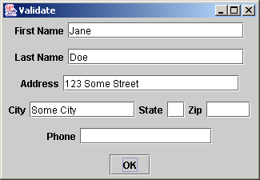
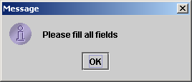
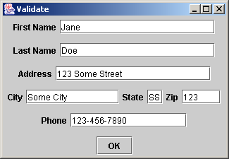
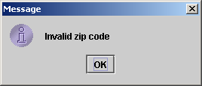

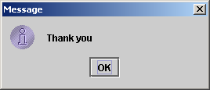
Sample code – ValidateFrame.java
Error message if TextBox left blank
Signal that the “Zip” TextBox was entered improperly
Signify that all the TextBoxes were entered in correct format

Slide 79
Sample code – RegexSubstitution.java
1 // Sample code: RegexSubstitution.java 2 // Using methods replaceFirst, replaceAll and split. 3 import javax.swing.*; 4 5 public class RegexSubstitution 6 { 7 public static void main( String args[] ) 8 { 9 String firstString = "This sentence ends in 5 stars *****"; 10 String secondString = "1, 2, 3, 4, 5, 6, 7, 8"; 11 12 String output = "Original String 1: " + firstString; 13 14 // replace '*' with '^' 15 firstString = firstString.replaceAll( "\\*", "^" ); 16 17 output += "\n^ substituted for *: " + firstString; 18 19 // replace 'stars' with 'carets' 20 firstString = firstString.replaceAll( "stars", "carets" ); 21 22 output += "\n\"carets\" substituted for \"stars\": " + firstString; 23 24 // replace words with 'word' 25 output += "\nEvery word replaced by \"word\": " + 26 firstString.replaceAll( "\\w+", "word" );
Replace every instance of “*” in firstString with “^”
Replace every instance of “stars” in firstString with “carets”
Replace every word in firstString with “word”

Slide 80
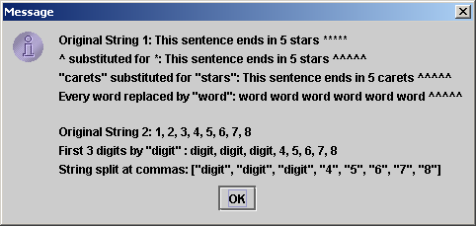
Sample code – RegexSubstitution.java
27 28 output += "\n\nOriginal String 2: " + secondString; 29 30 // replace first three digits with 'digit' 31 for ( int i = 0; i < 3; i++ ) 32 secondString = secondString.replaceFirst( "\\d", "digit" ); 33 34 output += "\nFirst 3 digits replaced by \"digit\" : " + 35 secondString; 36 output += "\nString split at commas: ["; 37 38 String[] results = secondString.split( ",\\s*" ); // split on commas 39 40 for ( int i = 0; i < results.length; i++ ) 41 output += "\"" + results[ i ] + "\", "; // output results 42 43 // remove the extra comma and add a bracket 44 output = output.substring( 0, output.length() - 2 ) + "]"; 45 46 JOptionPane.showMessageDialog( null, output ); 47 System.exit( 0 ); 48 49 } // end method main 50 51 } // end class RegexSubstitution
replaceFirst replaces a single occurrence of the regular expression
split returns array of substrings between matches of the regular expression

Slide 81
Sample code – RegexMatches.java
1 // Sample code: RegexMatches.java 2 // Demonstrating Classes Pattern and Matcher. 3 import java.util.regex.*; 4 import javax.swing.*; 5 6 class RegexMatches 7 { 8 public static void main( String args[] ) 9 { 10 String output = ""; 11 12 // create regular expression 13 Pattern expression = 14 Pattern.compile( "J.*\\d[0-35-9]-\\d\\d-\\d\\d" ); 15 16 String string1 = "Jane's Birthday is 05-12-75\n" + 17 "Dave's Birthday is 11-04-68\n" + 18 "John's Birthday is 04-28-73\n" + 19 "Joe's Birthday is 12-17-77"; 20 21 // match regular expression to string and print matches 22 Matcher matcher = expression.matcher( string1 ); 23 24 while ( matcher.find() ) 25 output += matcher.group() + "\n";
compile creates an immutable regular expression object
matcher associates a Pattern object with a string
find gets the first substring that matches the regular expression
group returns the matched substring

Slide 82
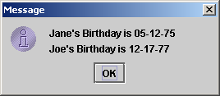
Sample code – RegexMatches.java
26 27 JOptionPane.showMessageDialog( null, output ); 28 System.exit( 0 ); 29 30 } // end main 31 32 } // end class RegexMatches

Slide 83
Thanks

